Slide 1
IoT - Temperature Logger

Slide 2
Block Diagram
LM35 Temperature Sensor
Temp
LiPo Battery
ATmega328
ESP-01 WiFi Module
5V
Payload
Charging
Discharging
5V
TP4056
Boost Converter
AMS1117 3.3V linear Regulator
Charger
3.7V
5V
3.3V

Slide 3
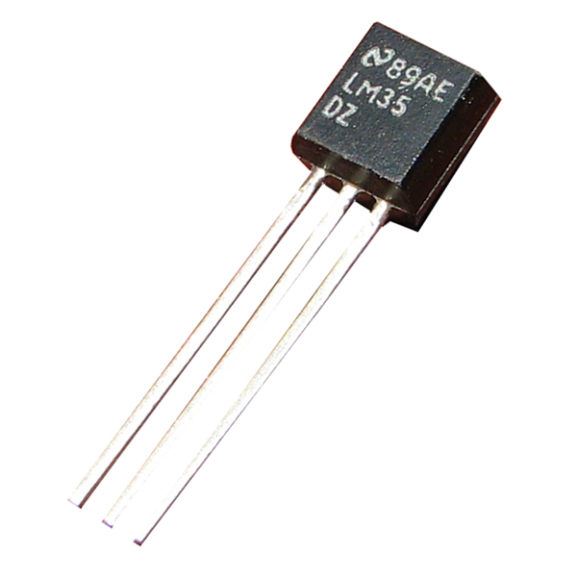
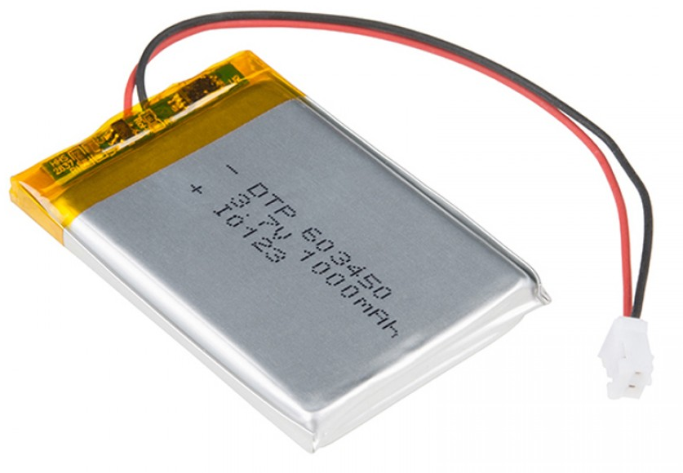
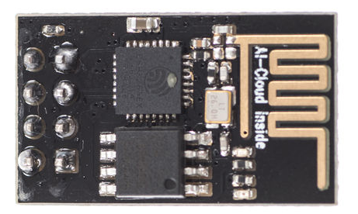
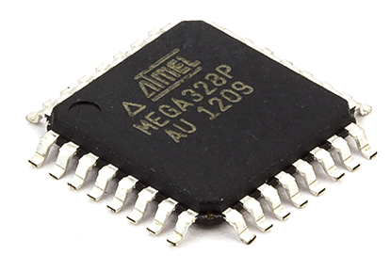
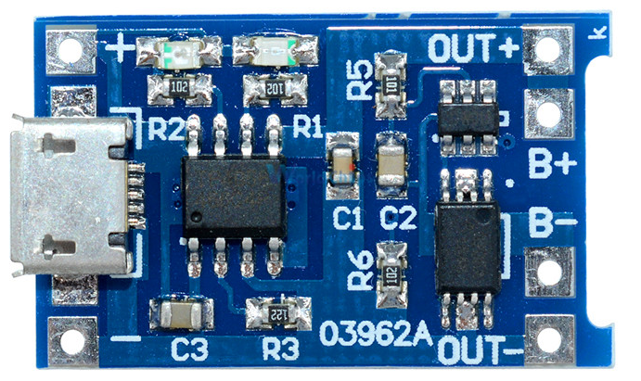
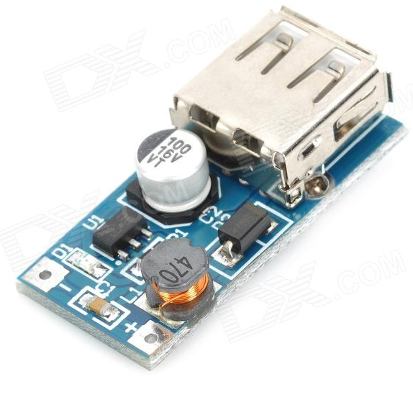
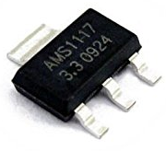
Module Diagram
Temp
5V
Payload
Charging
Discharging
5V
Charger
3.7V
5V
3.3V

Slide 4
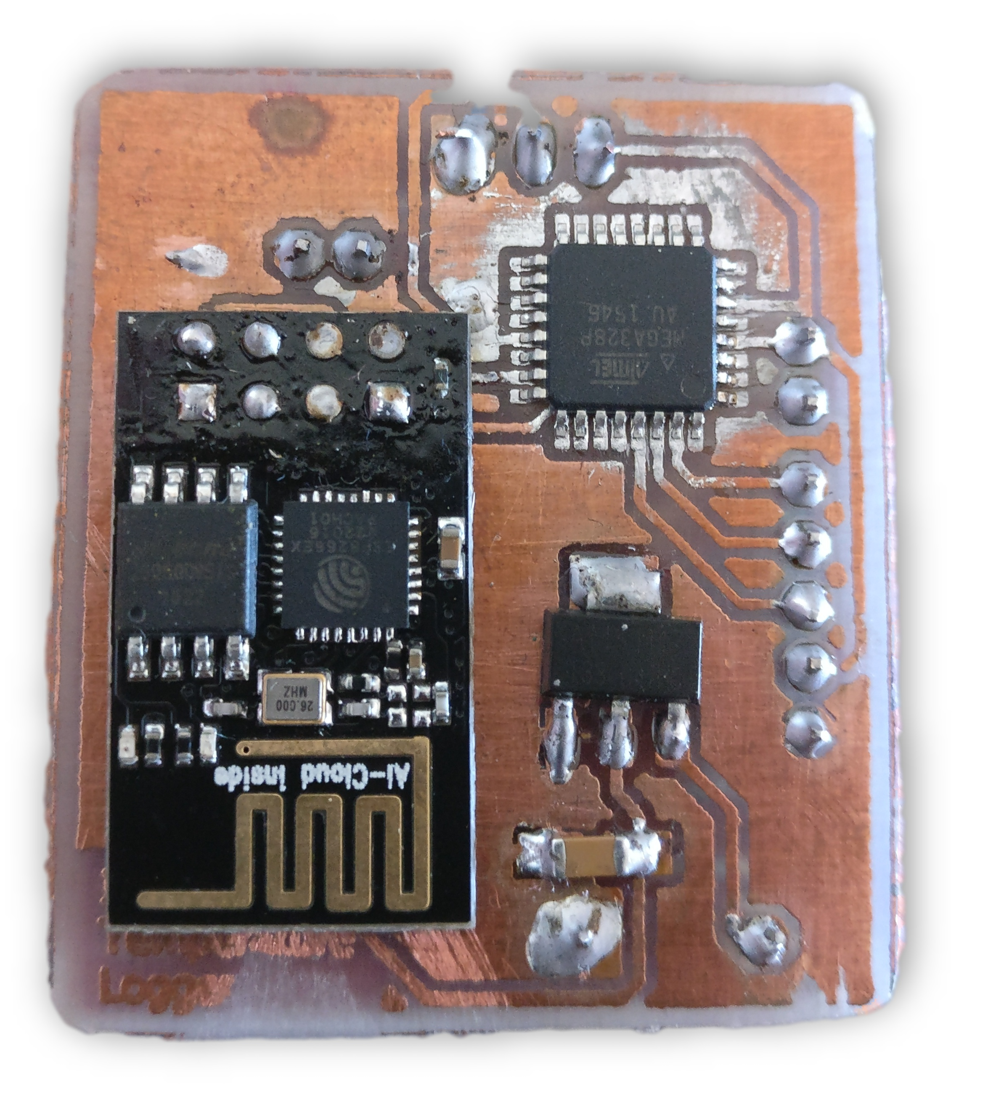
Board Layout op
ATmega328
ESP 01 Wifi Module
AMS1117 3.3V Regulator

Slide 5
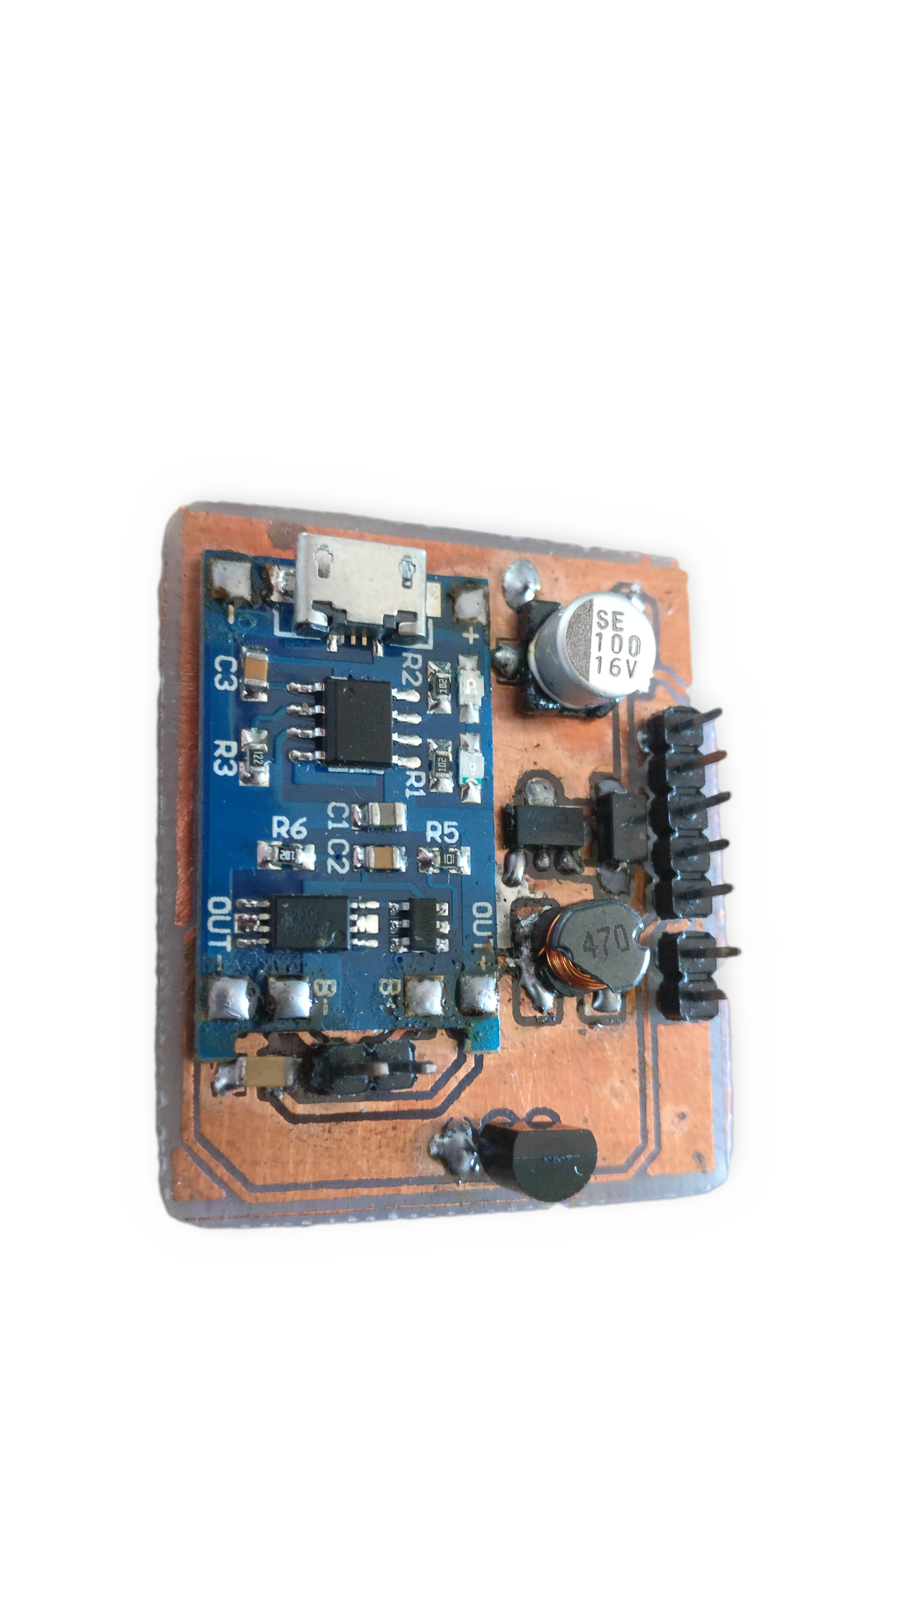
Board Layout Bottom
External Charger
Boost Converter
TP4056 Module
LM35 Temperature Sensor

Slide 6
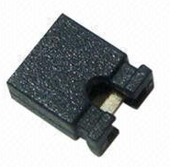
Board Pinout op
Battery -
Battery +
To Power MCU & LM35
ATmega VCC
VCC (5V)
TX (ATmega)
RX (ESP-01)
RX (ATmega)
TX (ESP-01)
RESET
VCC (5V)
GND

Slide 7
Board Pinout Bottom
GND
VCC (5V)
RESET
RX (ATmega)
TX (ESP-01)
TX (ATmega)
RX (ESP-01)
VCC (5V)
To Power MCU & LM35
ATmega VCC
Battery -
Battery +

Slide 8
Program The ATmega328
Computer Arduino IDE with Drago Board
ATmega VCC
TX (ATmega)
Arduino Uno (Without ATmega328)
RX (ATmega)
RESET
GND

Slide 9
Program The ESP-01
Computer Arduino IDE Serial Monitor (15200 & LN+CR)
RX (ESP-01)
TX (ESP-01)
Arduino Uno (Without ATmega328)
RESET
ATmega VCC
GND

Slide 10
Normal Operation
Battery -
Battery +
To Power MCU & LM35

